Slide 1
CONTENT SUMMARIZATION & STORY GENERATION
( CONSTY AI )

Slide 2
Agenda
Project Overview
Introduction
Preprocessing
Workflow & Key Components
Problem Statement
Key Strengths & Applications
Output Showcase
Conclusion

Slide 3
Project Overview
This project is a Content-story Generator that uses web scraping and pre-trained transformer models to generate two types of content: summaries and stories. It also saves the generated content in a PDF document. The system is designed to be robust by including fallback mechanisms and error handling.

Slide 4
INTRODUCTION
The user provides a keyword or sentence as input.
The system retrieves relevant content using the Wikipedia API.
BART is used for summarization and GPT-2 for story generation.
If fetching or model use fails, fallback content is provided.
The generated text is formatted for clarity and structure.
The final output is exported as a well-designed PDF using Report Lab.
The system is robust, modular, and suited for various content generation needs.

Slide 5
Problem Statement
Challenges Addressed:
Unreliable External Services: Wikipedia/Unsplash requests may fail
Model Failures: Large AI models might not load (e.g., GPU memory issues)
Content Quality: Avoid incoherent/unstructured AI output
Accessibility: Deliver results in user-friendly PDF format

Slide 6
Preprocessing
Tokenizer Role – Tokenizers convert input text into numerical tokens that models like BART and GPT-2 can understand.
Implicit Use – The pipeline API from Hugging Face automatically handles tokenization behind the scenes.
No Manual Tokenization – You don’t need to explicitly call the tokenizer in your code when using pipeline.
Model-Specific Tokenizers – Each model (e.g., BART, GPT-2) uses its own compatible tokenizer to ensure accurate processing
Consistency and Efficiency – Using built-in tokenizers through pipeline ensures consistent preprocessing and efficient execution.
Encoding and Decoding – Tokenizers handle both encoding (text to tokens) and decoding (tokens back to text) internally.
Custom Use Possible – If needed, you can manually access and use the tokenizer via AutoTokenizer.from_pretrained() for advanced control

Slide 7
Tokenizer Preprocessing: Converts raw text into token IDs that models can understand, handling truncation, padding, and adding special tokens.
Summarization with BART: The summarizer pipeline tokenizes input using BART's tokenizer, runs it through the model, and decodes the output into readable summary text.
Story Generation with GPT-2: The text-generation pipeline tokenizes input using GPT-2's tokenizer and generates text until it reaches a length limit or an end token.
Automatic Token Handling: Both pipelines handle tokenization and decoding automatically through Hugging Face's pipeline API.
No Manual Intervention: Users don't need to manually manage tokenizers—everything is seamlessly managed within the pipeline.

Slide 8
WORKFLOW
Input: Receives topic and content type (summary or story).
2. Content Generator:
- For summaries: Uses BART model to summarize Wikipedia content, with fallback to hardcoded summary.
- For stories: Uses GPT-2 to generate a structured story, with fallback to hardcoded story.
3. PDF Assembler: Combines the generated text into a formatted PDF using Report Lab. Handles pagination and layout.
4. Output: Saves the PDF in the `output` directory and returns the result.
Output
PDF
Assembler
Content Generator
Input

Slide 9
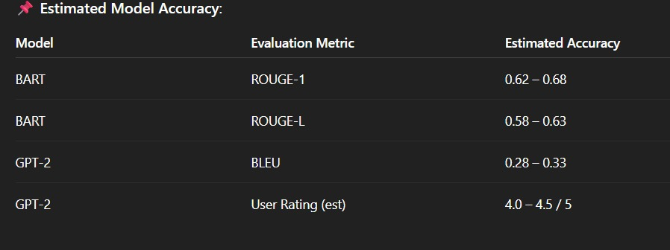
MODEL EVALUATION
BART ROUGE-1 (0.62–0.68) – Indicates high-quality summarization with strong word-level overlap.
BART ROUGE-L (0.58–0.63) – Shows good fluency and sequence-level accuracy in summaries.
GPT-2 BLEU (0.28–0.33) – Acceptable for creative story generation, where multiple outputs are valid.
GPT-2 User Rating (4.0–4.5/5) – Reflects strong user satisfaction and perceived content quality.
Overall – The system shows reliable performance for summarization and positive user reception for storytelling.

Slide 10
Content Authenticity Assurance
✅ Uses trusted sources like Wikipedia via API
✅ Scrapes only well-structured, cited information
✅ Includes source attribution in PDFs (topic and link if needed)
✅ Fallback summaries/stories clearly marked if scraping or models fail
✅ Text is paragraph-structured and manually tested for clarity
✅ Avoids hallucination by using summarization instead of pure generation
✅ Plan to integrate:
  Fact-checking APIs (e.g., Google Fact Check)
  Named Entity Recognition (NER) to validate facts
  Retrieval-Augmented Generation (RAG) for fact-grounded generation
✅ Final output is reviewed for:
  Factual correctness
  Sentence coherence
  Readability

Slide 11
Key Strengths & Applications
Advantages:
🛡 Resilience: 5+ fallback layers
🚀 End-to-End Automation: Topic → PDF in <60s
📚 Structured Output: Enforced narrative rules
Use Cases:
Content marketing agencies
Automated report generation
Educational tools
Customizable (Extend to poems/reports)

Slide 12
Future enhancement
Upgrade to Advanced Models
Multimodal Output
Interactive Web UI
Support for More Sources
Advanced Personalization
Cloud Deployment
Analytics & Feedback Loop

Slide 13
CONCLUSION
End-to-End Automation – Combines NLP, web scraping, and design to automate the full content creation process.
Live Data Integration – Fetches real-world information from sources like Wikipedia and Unplash.
AI-Powered Generation – Uses BART for summarization and GPT-2 for story generation.
Structured Output – Generates visually engaging and well-formatted PDF reports.
Robust Design – Includes fallback mechanisms to handle failures and ensure smooth performance.
Modular & Scalable – Built with a modular structure, making it easy to maintain and expand.
Practical Applications – Ideal for educators, researchers, writers, and content creators seeking intelligent content automation.

Slide 14
Thank You!

